Slide 1


딥러닝 기반 시공간 데이터 예측 연구
Research on Spatio-Temporal Data Prediction based on
Deep Learning
컴퓨터정보공학과
발표자：딩훼이쥐엔 지도교수：노기섭

Slide 2
CONTENTS
01
02
03
Research background
and significance
Related research
Research content
and methods
관련 연구
연구 배경 및 의의
연구 내용 및 방법
04
05
Key Innovations
and Achievements
Future research plans
향후 연구 계획
주요 혁신 및 결과물

Slide 3
01
Research background
and significance
PART ONE
연구 배경 및 의의

Slide 4
1.1 Research Background
연구 배경
1. Spatio-temporal data
2. Intelligent system
3. Spatio-temporal data prediction
4. Deep learning

Slide 5
1.1 Research Objectives
연구 목표
03.
01.
Capture longer-term spatio-temporal relationships
Construct a new deep network learning module
02.
04.
construct a spatio-temporal data prediction model
Carry out dynamic spatio-temporal feature learning to improve the effect of multi-task learning.

Slide 6
1.1 Research Significance
연구 의의
01
Enhance the prediction effect of spatio-temporal data and promote the development of modern intelligence
04
Provide reference for other studies
01
04
02
Establish and optimize spatio-temporal prediction models and extend them to applications in various fields
02
03
03
Optimize deep learning theory and develop deep learning research

Slide 7
02
Related research
PART TWO
관련 연구

Slide 8
2.1 spatio-temporal prediction method
CMAQ,WRF
RNN
LSTM
GRU
Traditional
methods
Deep
learning
methods
Spatio-temporal
data prediction
ARIMA
GWR
CNN
GCN
RF
SVM

Slide 9

2.2 Spatio-temporal dependency extraction
Time dependent extraction
01
02
03
RNN
LSTM
GRU
RLSTM
LSTME
IVLSTM-MCMR
LSTM-LSTM
Attention-LSTM
NA-BEMD
MLP-M
N-BEATS

Slide 10

2.2 Spatio-temporal dependency extraction
Spatial dependency extraction
CNN,CNN-LSTM,
CNN-biLSTM
GCN,GCN-LSTM
AutoGCN,NetGAN,GAGNN

Slide 11
03
Research content
and methods
PART THREE
연구 내용 및 방법

Slide 12
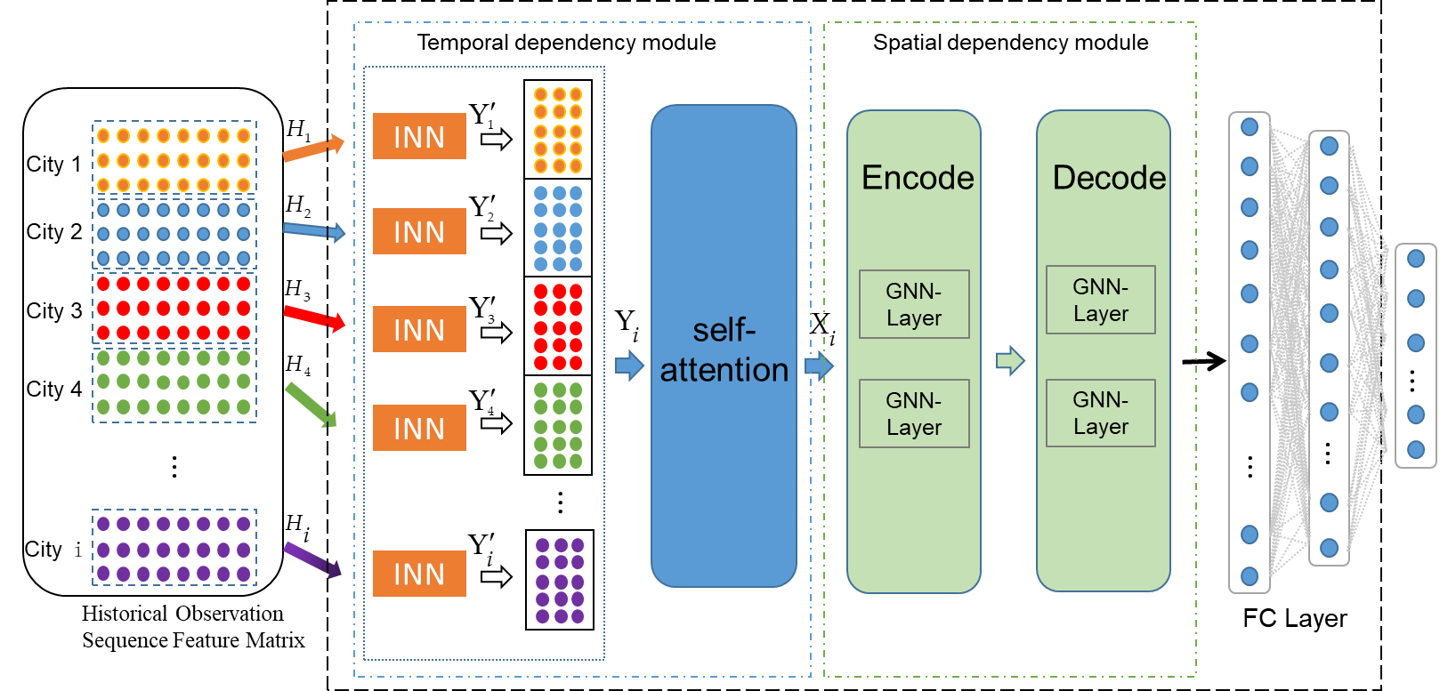
3.1 Research content
A Hybrid Model for Spatiotemporal Air Quality Prediction Based on INN and GNN
Spatiotemporal
prediction
model

Slide 13
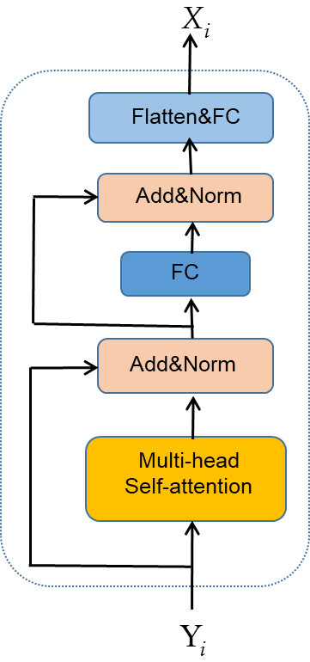
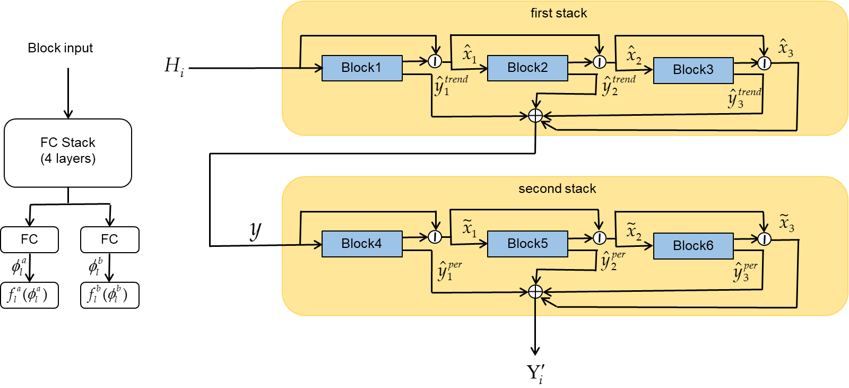
3.1 Research content
Time dependent module
Time dependent module
Timporal
dependency
module

Slide 14
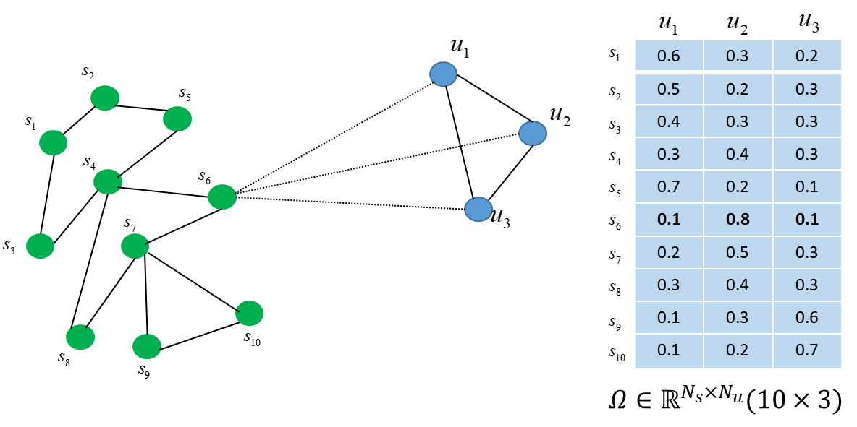
3.1 Research content
03
spatial
dependency
module

Slide 15
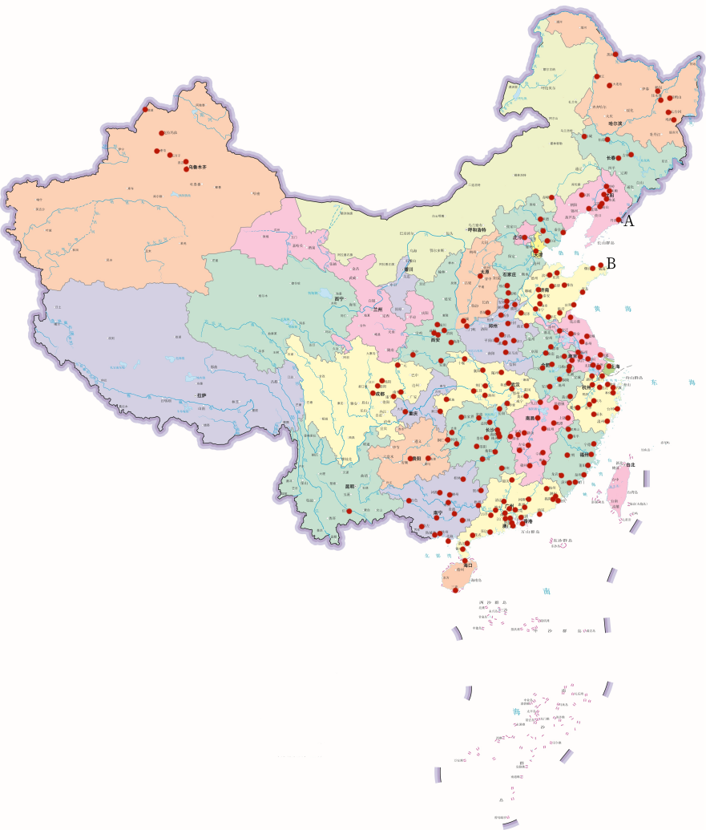
3.1 Research content
Data set
AQI data set
Weather data
humidity, wind direction, rainfall, wind speed, air pressure, temperature, and visibility.
Geographic location data

Slide 16
3.1 Research methods
Correlative research
and analysis
Data analysis
Experimental research
Comparative research

Slide 17
04
Key Innovations and
Achievements
PART FRUR
주요 혁신 및 결과물

Slide 18
4.1 key innovation
A new network structure is proposed to capture the trend and periodicity of time series.
A fusion method is proposed to capture the dependence of time and space for dynamic spatio-temporal feature learning.
Integrated with GNN for grouping and composition module, it enhances the association between complex nodes and edges.
The fusion model can adaptively adjust the information weight of the two modules to improve the efficiency of long-distance information transmission.

Slide 19
4.2 Expected Achievements
paper 1 (SCI Under review)
Spatiotemporal Data prediction model 1 (completed)
A Hybrid Model for Spatiotemporal Air
Quality Prediction Based on INN and GNN
A Hybrid Model for Spatiotemporal Prediction Based on INN and GNN
paper 2 (SCI unpublished)
Spatiotemporal Data prediction model 2 (uncompleted)
The experiment has been completed and a paper will be written

Slide 20
05
Future research
plans
PART five
향후 연구 계획

Slide 21
5.1 Research plan
2023.10-2023.12
2024.04
SCI paper 2 writing
Professor review and revision
Paper 2 submission and publication
Review and revision of first draft of paper
2023.01-2023.09
2024.01-2024.03
2024.05
SCI paper 1 writing
Professor review and revision
Paper submission and publication
Graduation thesis writing
Graduation thesis draft completed
Graduation thesis preparation and defense

Slide 22
—— References
Zhang, L.; Lin, J.; Qiu, R.; Hu, X.; Zhang, H.; Chen, Q.; Tan, H.; Lin, D.; Wang, J. Trend Analysis and Forecast of PM2.5 in Fuzhou, China Using the ARIMA Model. Ecol. Indic. 2018, 95, 702–710,
Chen, L.; Xu, J.; Wu, B.; Qian, Y.; Du, Z.; Li, Y.; Zhang, Y. Group-Aware Graph Neural Network for Nationwide City Air Quality Forecasting 2021.
Baek, J.; Lee, C.; Yu, H.; Baek, S.; Lee, S.; Lee, S.; Park, C. Automatic Sleep Scoring Using Intrinsic Mode Based on Interpretable Deep Neural Networks. IEEE Access 2022, 10, 36895–36906.
Huang, D.; Tang, S.; Zhou, D.; Hao, J. Nox Emission Estimation in Gas Turbines via Interpretable Neural Network Observer with Adjustable Intermediate Layer Considering Ambient and Boundary Conditions. Measurement 2022, 189, 110429.
Fang, W.; Zhu, R.; Lin, J.C.-W. An Air Quality Prediction Model Based on Improved Vanilla LSTM with Multichannel Input and Multiroute Output. Expert Syst. Appl. 2023, 211, 118422.
Zhu, J.; Deng, F.; Zhao, J.; Zheng, H. Attention-Based Parallel Networks (APNet) for PM2.5 Spatiotemporal Prediction - ScienceDirect. Sci. Total Environ. 2021.
Yan, R.; Liao, J.; Yang, J.; Sun, W.; Nong, M.; Li, F. Multi-Hour and Multi-Site Air Quality Index Forecasting in Beijing Using CNN, LSTM, CNN-LSTM, and Spatiotemporal Clustering. Expert Syst. Appl. 2021, 169, 114513.
Yu, B.; Yin, H.; Zhu, Z. ST-UNet: A Spatio-Temporal U-Network for Graph-Structured Time Series Modeling 2021.
Zhang, B.; Zhang, H.; Zhao, G.; Lian, J. Constructing a PM2.5 Concentration Prediction Model by Combining Auto-Encoder with Bi-LSTM Neural Networks. Environ. Model. Softw. 2019, 124, 104600.
Wu, C.; He, H.; Song, R.; Peng, Z. Prediction of Air Pollutants on Roadside of the Elevated Roads with Combination of Pollutants Periodicity and Deep Learning Method. Build. Environ. 2022, 207, 108436.

Slide 23
——Thanks——
지도해 주신 교수님께 감사드립니다!
교수님의 가르침에 감사드립니다!
도와준 반 친구들에게 감사합니다!
경청해 주신 교수님들 감사드립니다!

Slide 24
조언 부탁드립니다!
Please give me some advice!
딩훼이쥐엔

