Slide 1
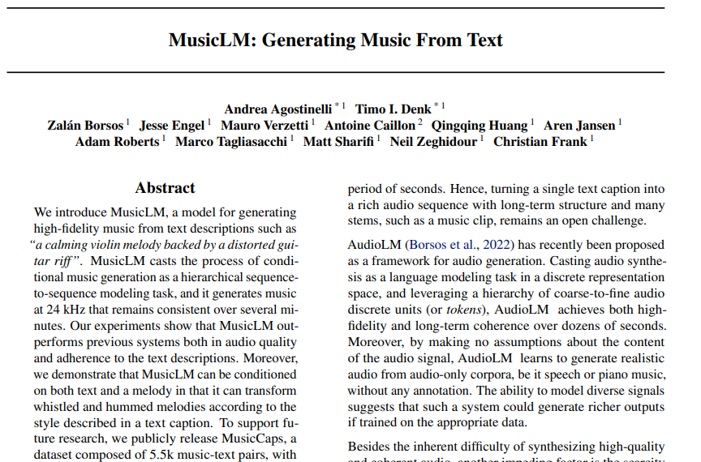

Slide 2
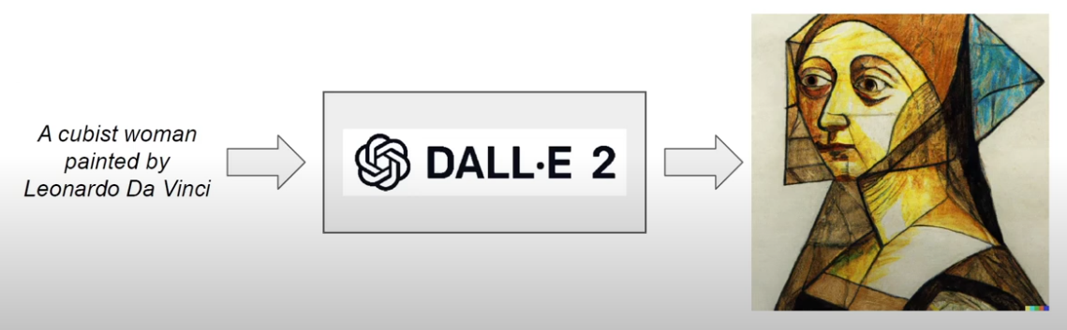
Text-to-image generation

Slide 3
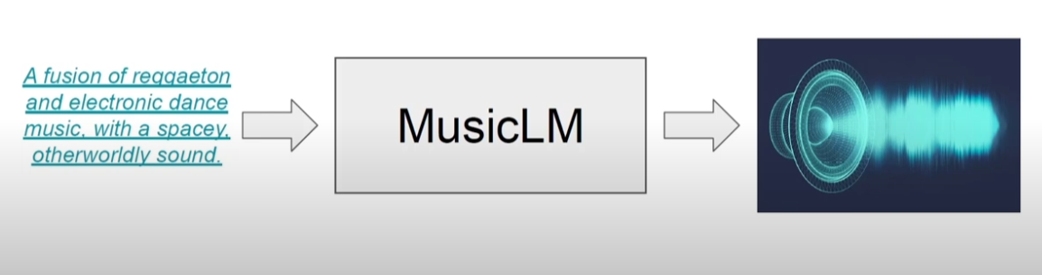
Text-to-music generation(TTM)

Slide 4
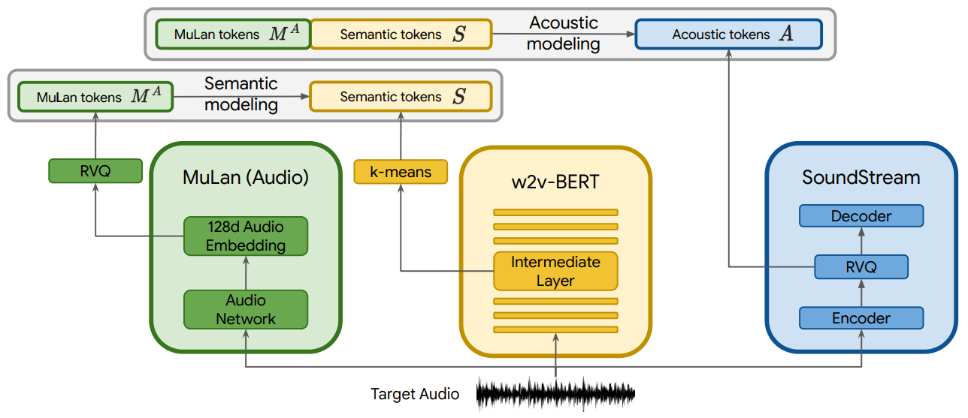
The architecure

Slide 5
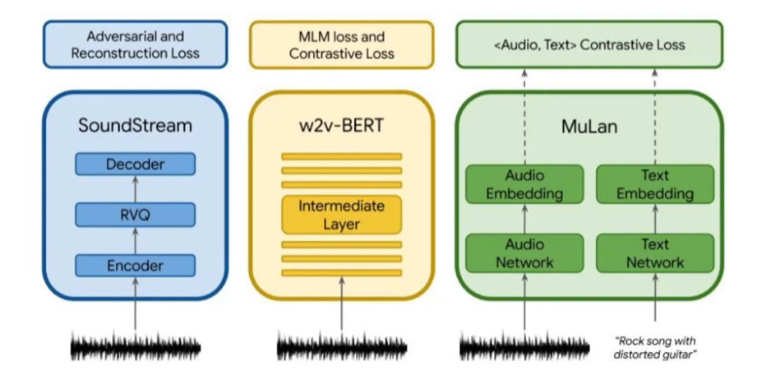
The components

Slide 6
SoundStream(Zeghidour et al., 2022)
Neural audio codec
Compress audio at lower bit rate
Maintain high reconstruction quality(24 kHz)
Residual Vector Quantization(RVQ)

Slide 7
w2v-BERT(Chung et al., 2021)
BERT for audio(originally trained on speech)
Take care of semantic information
Model long-term structure

Slide 8
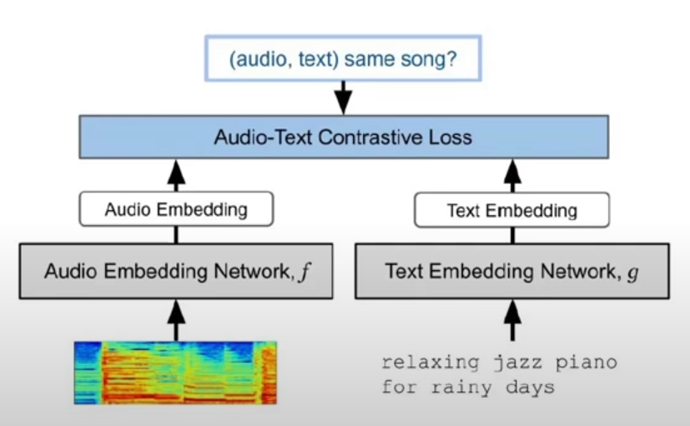
MuLan(Huang et al., 2022)
Music-text joint embedding -> link music to free-form description
Two embedding towers (audio + text)
Text-embedding network is BERT pre-trained on text
Audio-embedding network is ResNet-50
Trained on pairs of music clips and their corresponding text annotation

Slide 9
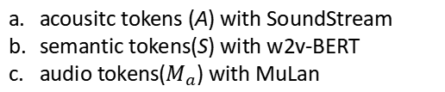
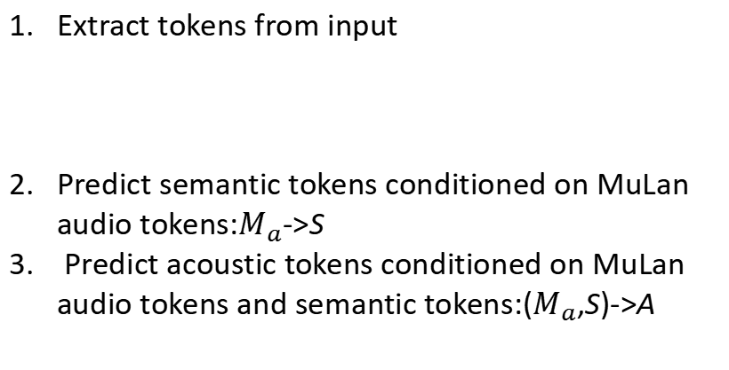
Training steps
Extract tokens from input
Predict semantic tokens conditioned on MuLan audio tokens:$M_{a}$->S
Predict acoustic tokens conditioned on MuLan audio tokens and semantic tokens:($M_{a}$,S)->A
acousitc tokens (A) with SoundStream
semantic tokens(S) with w2v-BERT
audio tokens($M_{a}$) with MuLan

Slide 10
More on training
Each stage is modelled autoregressively as a sequence-to-sequence task using decoder-only Tranformers

Slide 11
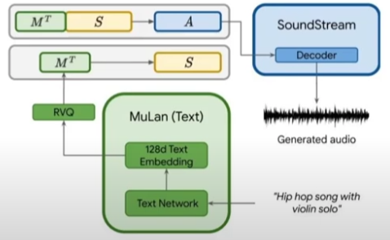
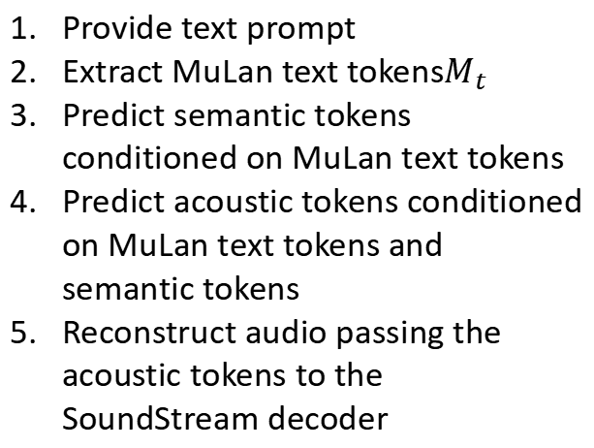
Inference
Provide text prompt
Extract MuLan text tokens$M_{t}$
Predict semantic tokens conditioned on MuLan text tokens
Predict acoustic tokens conditioned on MuLan text tokens and semantic tokens
Reconstruct audio passing the acoustic tokens to the SoundStream decoder

Slide 12
Why acoustic and semantic stages?
Acoustic model captures fine-grained acoustic details
Semantic model improves long-term music structure+adherence to text descriptions

Slide 13
Clever tricks
SoundStream made it possible to generate tokens instead of waveforms -> lower dimensionality
MuLan made it possible to use audio dataset without text descriptions

Slide 14
Experiments
Training data
Evaluation
Pretrained and frozen MuLan model
SoundStream and w2v-BERT trained on the Free Music Archive dataset
Autoregressive models trained on 280k hours of music at 24 kHz
Trained with 30- and 10-second audio clips
Quantitative and expert-based evaluations
New dataset (MusicCaps)-> 5.5k music clips from AudioSet with text

Slide 15
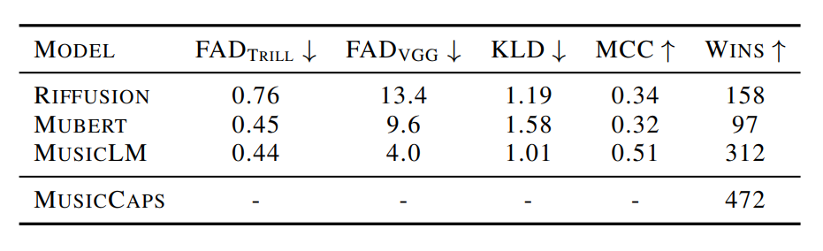
Results
MusicLM outperforms Riffusion and Mubert AI
Better audio-fidelity
Better adherence to text input

Slide 16
Limitations
Long-term structure isn't convincing -> not evaluated
Audio fidelity is OK but not ready for production
Minimal creative control
A tool for TikTokers not for high-end creators and musicians

Slide 17
THANKS!

